Slide 1

MTech in CSE (2024 - 2026)
Semester - IV
UE24CS7A1A - Project Work Phase - 2
Review - 1
Project Title : Real-Time Multi-Camera Person Tracking and Re-identification System
Project ID : PW_24_CN_02
Project Guide : Dr. Chaitra N
Student Name : Durgesh Gowda C
Student SRN : PES1PG24CS023

Slide 2
Problem Statement
Surveillance systems use multiple cameras but monitoring them manually is difficult and inefficient.
Most systems can track a person only within one camera view.
They fail to recognize the same person across different cameras due to changes in lighting, angle, or appearance.
This leads to fragmented tracking and reduced effectiveness in real-time monitoring.
This project aims to build a real-time multi-camera person tracking and re-identification system using computer vision and deep learning.

Slide 3
Scope
Develop a real-time system that can detect, track, and identify people across multiple CCTV cameras.
Implement person detection, single-camera tracking, and cross-camera re-identification modules.
Integrate results from multiple cameras to maintain a consistent global identity for each person.
Evaluate system performance on standard datasets and sample CCTV footage.
Demonstrate potential for use in security, smart surveillance, and crowd monitoring applications.

Slide 4
Applications/Use cases
Smart Surveillance and Security
Public Safety & Law Enforcement
Retail and Commercial Analytics
Smart Cities

Slide 5
Design Constraints, Assumptions & Dependencies
Constraints
Real-time processing on consumer hardware
Limited camera overlap
Appearance-based tracking without face recognition
CPU/MPS-based inference (no dedicated GPU required)
Assumptions
Cameras are static
People move at normal walking speeds
Person appearance remains moderately consistent
Bounding boxes are reasonably accurate
Dependencies
Camera availability and permissions
Lighting conditions
Detection accuracy
Stable frame capture rate

Slide 6
Technologies Used
Programming Language: Python
Detection Model: YOLO (Ultralytics)
Tracking Algorithm: ByteTrack
Feature Extraction: OSNet
Similarity Search: FAISS
Computer Vision: OpenCV
Deep Learning Framework: PyTorch
Data Storage: Pickle + FAISS Index
Visualization: OpenCV UI

Slide 7
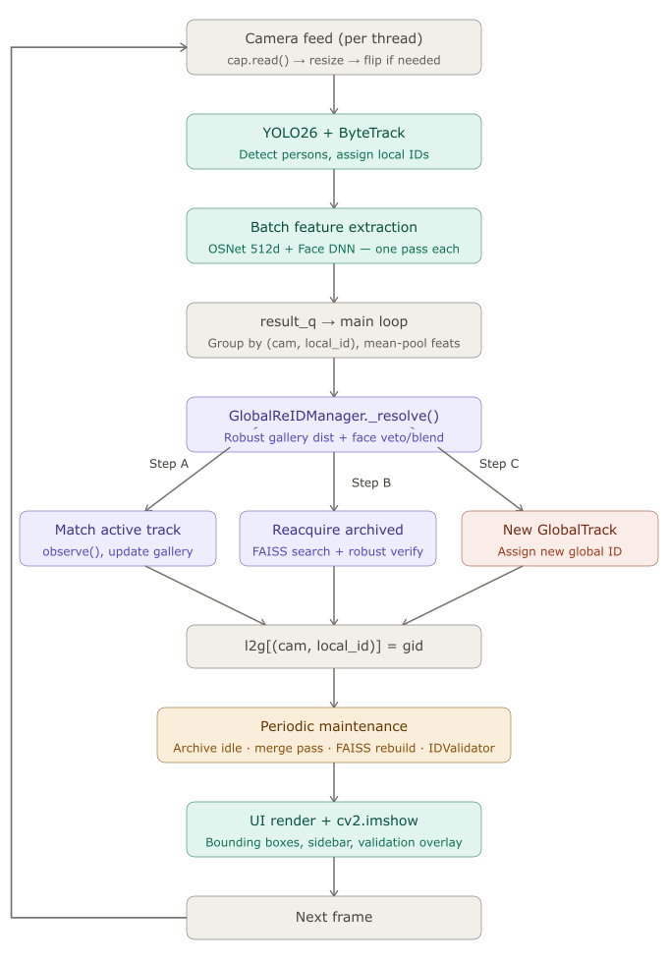
Flow Diagram

Slide 8
System Architecture (3 Tiers)
Camera Tier — One thread per camera: YOLO26 detection + ByteTrack tracking + OSNet embedding extraction. Optional face detection on upper crop.
ReID Tier — GlobalReIDManager runs three-step resolve pipeline. Archives dormant identities. Periodic merge pass fixes fragmentation.
UI & Persistence Tier — Live camera tiles, sidebar stats, ID validation alerts. SessionRecorder for offline benchmarking.

Slide 9
Robust Gallery Distance Why Not Simple Minimum Distance?
Minimum distance is vulnerable to a single blurry/occluded frame
FoundYou uses median per camera (immune to 50% outliers)
Then averages with merged gallery mean to prevent any single well-lit camera from dominating
Formula: drob = ½ × [ per-camera median cosine + merged-mean cosine ]

Slide 10
Three-Step Resolve Pipeline
Step A — Active Match
Four false-positive guards: camera occupancy check, gallery maturity gate (MIN_PROBES), per-scenario distance thresholds (0.30 same-cam / 0.40 cross-cam), robust distance replaces naive minimum
Step B — Reacquisition
FAISS index search over archived tracks → verified again by drob and face veto
Step C — New Track
If Steps A & B both fail → assign a new unique global ID

Slide 11
Post-Hoc Active-Track Merge
The Fragmentation Problem Early encounters have < MIN_PROBES features → Steps A/B cannot yet match → two IDs may be created for the same person
Solution: Every 2 seconds, evaluate all active track pairs:
Merge: if robust distance < 0.35 AND tracks are not simultaneously live on the same camera
Winner = track with more detections; loser's features are absorbed
δmerge = 0.35 < δcross = 0.40 → only confident merges happen

Slide 12
Optional Face Layer Face as Veto + Score Blend
Face detection on top 50% of each body crop
Quality score = 0.5 × sharpness + 0.3 × size + 0.2 × aspect ratio
Only high-quality, high-confidence faces are used
Two roles:
Veto — if face cosine distance > 0.55, block the body-match
Blend — if both sides are usable: d = 0.7 × body + 0.3 × face
Falls back to body-only gracefully when face is absent.

Slide 13
Runtime ID Validation IDValidator (3 Alerts)
Alert | Condition | Likely Cause
SWAP | drob < 0.28 across cameras | Flipped camera / similar clothing
DUPLICATE | Same camera, d < δmerge | ByteTrack split one person into two
UNSTABLE | High intra-gallery variance > 0.30 | Gallery contaminated by multiple IDs

Slide 14
Expected Deliverables (continued)
Phase / Task | Description | Duration | Timeline (Weeks)
1. Project Planning & Research | Review literature, define objectives, gather resources | 2 weeks | Week 1 - 2
2. System Design & Architecture | Design system modules: detection, tracking, ReID, database | 2 weeks | Week 3 - 4
3. Data Collection & Preprocessing | Collect CCTV/video data, prepare datasets for training/testing | 1 weeks | Week 5
4. Model Selection & Development | Implement YOLOv8 for detection and FastReID for ReID | 3 weeks | Week 6 - 8
5. Integration & Real-Time Pipeline | Combine detection, tracking, and cross-camera ID modules | 2 weeks | Week 9 - 10
6. Testing & Evaluation | Evaluate with MOTA, IDF1, and mAP metrics; optimize performance | 2 weeks | Week 11 - 12
7. Documentation & Report Writing | Prepare project report, code documentation, and presentation | 2 weeks | Week 13 - 14
8. Final Presentation & Demo | Present working prototype and final results | 1 week | Week 15

Slide 15
Problems Faced
Camera Clarity (low resolution and differential resolution)
Camera Angle
Occlusion
Partial visibility or no visibility of Faces
Lighting
Clothes (Changing and Uniform)
Cross-Camera ID matching

Slide 16
Results
Significant reduction in ID switching
Accurate re-identification after occlusion
Stable identity tracking across cameras
Controlled and safe ID reuse
Real-time performance on standard hardware
Improved robustness compared to baseline trackers

Slide 17
THANK YOU

